Slide 1






ECOS: Leveraging Software-Defined Networks to Support Mobile Application Offloading
ABC
Aaron Gember, Christopher Dragga, Aditya Akella
University of Wisconsin-Madison

Slide 2



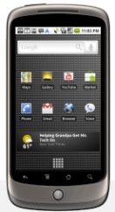
Mobile Device Trends
More mobile device usage in enterprises
  Need to run complex applications
Complex mobile applications have significant CPU, memory, and energy demands
Devices are limited in all three
Need to reconcile application
demands and device capabilities

Slide 3




Designing for Remote Computation
Mobile apps designed to use remote services
  e.g., Google Voice Search, Apple’s Siri, Amazon Silk
  Requires developers to use this paradigm
Remote desktop / VNC
  User interface not designed for mobile devices

Slide 4

Application-Independent Offloading
Dynamically divide execution between mobile device and compute resource
  Application code unmodified
  Informed by model and/or runtime monitoring
Several proposed systems – Chroma [Balan et al. 2003], MAUI [Cuervo et al. 2011], CloneCloud [Chun et al. 2011]
ABC

Slide 5

Roadblocks to Offloading Adoption
Privacy and trust
  Proposed systems largely ignore privacy
  Privacy is paramount in enterprises
Resource sharing and churn
  Proposed systems consider one device,
  plus a dedicated resource
  Enterprises have many devices and a changing pool of resources

Slide 6







Opportunities in Enterprises
Diverse unused compute capacity
Tight administrative control
Network flexibility and visibility through Software-Defined Networking (SDN)

Slide 7

Software Defined Networking
Centralized view of network
Fine-grained control
  Pair individual devices and resources
  Minimize security risks

Slide 8

Enterprise-Centric Offloading System
allows many devices to opportunistically
leverage diverse compute resources,
while controlling where applications
offload depending on privacy, performance,
and energy constraints of users and apps.
Leverage software-defined
networking (SDN)
+

Slide 9
Outline
Offloading benefits and roadblocks
Addressing privacy and trust
Resource sharing and churn
ECOS prototype
Evaluation for a small enterprise setting

Slide 10

Privacy and Trust
Security is paramount in enterprises
Offloading may cause data to leave device
Challenges
  When should security be applied?
  How to secure offloading?
  Offloading benefits and opportunities should
  not be significantly diminished

Slide 11
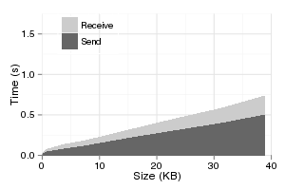
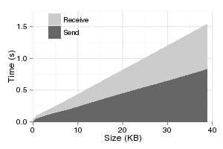
Overhead of Security Mechanisms
Encrypting state in transit with TLS
  High latency and energy overhead
Limited number of trusted compute resources
  Reduced offloading opportunities
Encrypted
Unencrypted

Slide 12
Security Policy
Security policy provided to SDN controller
  Privacy levels for devices & applications
  Trust levels for compute resources
Choose between three privacy levels
  Differ in trusted resources and use of encryption

Slide 13



Privacy Levels
Privacy Level | Resources Trusted | Require Encryption
None | Any | Never
Enterprise | All internal resources | Never
User | Select servers and desktops | Always

Slide 14
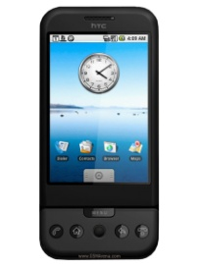


Security Example

Slide 15
Security Mechanisms
Always enforce encryption and resource selection decisions using SDN
  Default off-network
  Only allow flows on specific ports and between specific mobile devices and compute resources
  Remove forwarding rules to stop rogue offloads

Slide 16



Resource Sharing and Churn
Existing frameworks consider one
device and assume static resources
  Negative interactions between offloads
  Potentially ignores available resources
Challenges
  Devices with varying applications and objectives
  Limited resources and diverse capabilities
  Offload requests not know a priori

Slide 17


Multiplexing Based on Objective
Consider any available (trusted) resource
  Resources report to SDN controller
Assign resources based on objective
  Performance improvement: use resources with unused CPU > mobile CPU speed
  Energy savings: use separate resources from performance seeking offloads

Slide 18

Resource Affinity
Use same resource for subsequent offloads
  Cache state → less latency and energy overhead
  Assumes constant resource availability/capacity
Resource not capable/available
  Deny offloads until capacity increases
  Assign a new resource: retransfer state
X

Slide 19
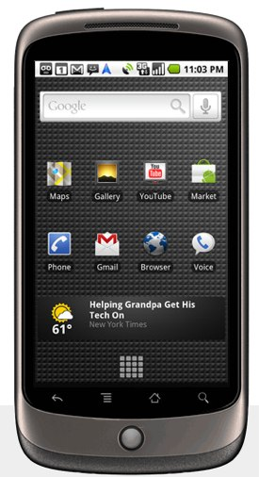

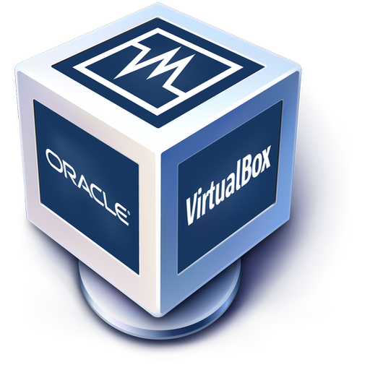

Prototype
1110101011
0001101001
1101010110

Slide 20
Evaluation
Small enterprise setting
  12 phones (Android emulator)
  4 to 6 desktops (2.4Ghz quad-core, 4GB RAM)
Two applications :
  AI-decision making (Chess)
    50 moves
    No privacy
  Speech-to-text (emulated)
    20 recognitions
    User privacy
  Significant computation, small state
  Actual enterprise applications expensive

Slide 21
Performance Improvement

Slide 22
Energy Savings

Slide 23
Resource Allocation Efficiency

Slide 24
Summary
Enterprise-Centric Offloading System
  Leverages software-defined networking
  Accommodates trust and privacy concerns
  with minimal complexity and overhead
  Scales offloading to many mobile devices, and opportunistically leverages diverse resources
ABC

