Slide 1



CAP: Detecting Network Device Misconfigurations with
Context-Aware Prompting of LLMs
Xi (Chase) Jiang, Aaron Gember-Jacobson, Nick Feamster
Notes:
Our work on how to more effectively use LLMs to detect errors in network device configurations

Slide 2





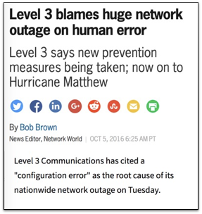


Network configurations are…
Integral
Complex
Error prone
BGP
BGP
OSPF
OSPF
VLAN
VLAN
OSPF
VLAN
VLAN
Notes:
Settings on routers, switches, firewalls, etc. that influence how traffic traverses the network
Integral to security, performance, and stability
Complex: multitude of protocols and filters; hundreds or thousands of lines of sophisticated vendor-specific language
Engineers rely on extensive knowledge gained from years of experience and vast vendor documentation to create/update configs
Challenging for humans to fully reason about the impact of a change, and even a small error can have a significant negative impact

Slide 3







Classic configuration verifiers
Model checkers
Batfish, Minesweeper, Plankton, etc.
Consistency checkers
Minerals, SelfStarter, Diffy, etc.
High manual effort to correctly define models and policies
Neglects semantics and
intentional deviations
Outputs are not intuitive
for human engineers
Notes:
Researchers and practitioners have developed configuration verifiers to proactively identify misconfigurations
Model checkers reason about how the network will function under certain configurations to determine whether specific forwarding policies will be satisfied

Slide 4



LLMs are promising…
Extensive pre-training
Context-aware reasoning
Natural language explanations
The error is caused by…

Slide 5

How do we effectively use LLMs for configuration verification?

Slide 6

Today’s talk
Configuration complexity & flawed LLM-based approaches
Our approach: Context-Aware Prompting (CAP)
  Context mining
  Guided prompting
Evaluation

Slide 7
Configuration complexity
Structural
  Nesting
  References
  Length
Semantic
11 interfaces {
12 ge-0/0/1 {
13 unit 0 {
14 family ethernet-switching {
15 interface-mode trunk;
16 vlan-members [ 10 20 ];
17 filter { input DEMO-FILTER; }
...
31 ge-0/0/2 {
32 unit 0 {
33 family ethernet-switching {
34 interface-mode access;
35 vlan-id 10;
36 filter { input SAMPLE-FILTER; }
...
151 protocols {
152 bgp {
153 group EBGP-PEER {
154 type external;
155 peer-as 65002;
156 neighbor 10.0.2.2;
...
271 firewall {
272 family ethernet-switching {
273 filter DEMO-FILTER {
274 term ALLOW-INTERNAL {
275 from { source-address 10.0.0.0/16; }
276 then accept;
277 }
...

Slide 8
Flawed approaches to LLM-based verification
Full configuration
Partitions (e.g. Ciri)
Chain-of-thought
Exceeds token limits and
causes context overload
Fragments context ⇒ limits consideration of references
Reasoning strategy still prone to
excessive/insufficient context

Slide 9

Insight: experts focus on relevant configuration
11 interfaces {
12 ge-0/0/1 {
13 unit 0 {
14 family ethernet-switching {
15 interface-mode trunk;
16 vlan-members [ 10 20 ];
17 filter { input DEMO-FILTER; }
...
31 ge-0/0/2 {
32 unit 0 {
33 family ethernet-switching {
34 interface-mode access;
35 vlan-id 10;
36 filter { input SAMPLE-FILTER; }
...
151 protocols {
152 bgp {
153 group EBGP-PEER {
154 type external;
155 peer-as 65002;
156 neighbor 10.0.2.2;
...
271 firewall {
272 family ethernet-switching {
273 filter DEMO-FILTER {
274 term ALLOW-INTERNAL {
275 from { source-address 10.0.0.0/16; }
276 then accept;
277 }
...

Slide 10
Today’s talk
Configuration complexity & flawed LLM-based approaches
Our approach: Context-Aware Prompting (CAP)
  Context mining
  Guided prompting
Evaluation

Slide 11
1. Context mining: types of context
Neighboring
Similar
Referenced
11 interfaces {
12 ge-0/0/1 {
13 unit 0 {
14 family ethernet-switching {
15 interface-mode trunk;
16 vlan-members [ 10 20 ];
17 filter { input DEMO-FILTER; }
...
31 ge-0/0/2 {
32 unit 0 {
33 family ethernet-switching {
34 interface-mode access;
35 vlan-id 10;
36 filter { input SAMPLE-FILTER; }
...
151 protocols {
152 bgp {
153 group EBGP-PEER {
154 type external;
155 peer-as 65002;
156 neighbor 10.0.2.2;
...
271 firewall {
272 family ethernet-switching {
273 filter DEMO-FILTER {
274 term ALLOW-INTERNAL {
275 from { source-address 10.0.0.0/16; }
276 then accept;
277 }
...

Slide 12
1. Context mining: references
Challenge: ambiguity
  Primitives vs references
  Context-sensitive
Solution: leverage LLM
interface ge-0/0/1
mtu 2500
switchport mode access
switchport access vlan 2500
!
vlan 2500
description Printers
!
access-list 2500 permit ip 192.168.0.0 0.0.255.255
Classify the terminal value in the line under review as either a pre-defined value that is part of the configuration language or a custom, user-defined identifier.
Notes:
`

Slide 13
2. Guided prompting
Initial prompt to LLM
LLM requests context
Provide context to LLM
LLM’s final analysis
I have a line of configuration for a Juniper router and need to determine if there is any misconfiguration:
interfaces→ge-0/0/1→unit→0→family→ethernet-switching→filter→input=DEMO-FILTER
Additional contextual information with respect to the configuration line under review can be provided upon request: (1) neighboring configuration lines, (2) similar configuration lines, (3) referenced configuration lines, (4) referenced configuration lines for neighboring configuration lines
Respond in a JSON format strictly adhering to the following:
...
{
requestedInfo: [1, 2],
reason: ["Neighboring configuration lines are necessary to confirm if the filter is
appropriate for the configured VLANs", ...]
}
Neighboring configuration lines:
- interfaces→ge-0/0/1→unit→0→family→ethernet-switching→interface-mode=trunk
- interfaces→ge-0/0/1→unit→0→family→ethernet-switching→vlan-members[0]=10
- interfaces→ge-0/0/1→unit→0→family→ethernet-switching→vlan-members[1]=20
Similar configuration
- interfaces→ge-0/0/2→unit→0→family→ethernet-switching→filter→input=SAMPLE-FILTER
{
misconfigured: true,
parameter: input,
reason: "DEMO-FILTER should only be used for VLAN 10, because the filter is configured
only to allow traffic from the subnet 10.0.0.0/16”
}

Slide 14
Today’s talk
Configuration complexity & flawed LLM-based approaches
Our approach: Context-Aware Prompting (CAP)
  Context mining
  Guided prompting
Evaluation

Slide 15
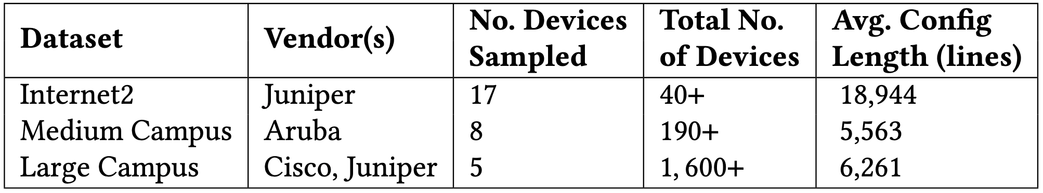





Evaluation: Setup
Networks
Models

Slide 16
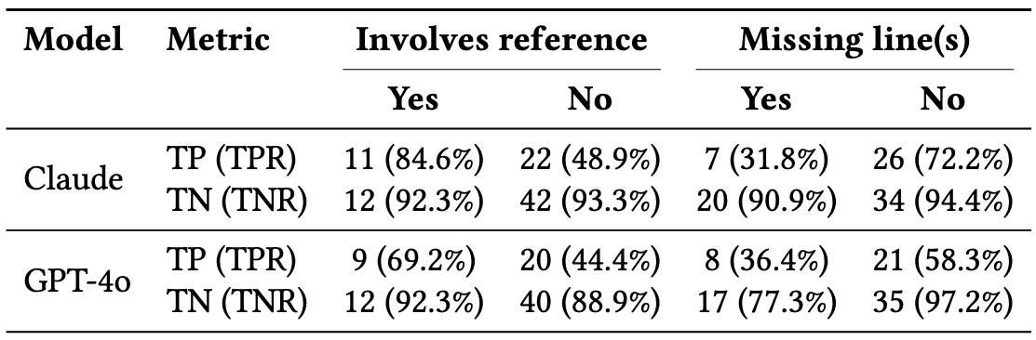
Evaluation: Accuracy on synthetic misconfigurations
58 synthetic updates to various components of Internet2 configurations based on real-world misconfigurations reported in prior research
👍 Reliably detects
misconfigurations
involving references
👍 Minimal spurious
misconfigurations
👎 Challenging to detect
misconfigurations
involving missing lines
Notes:
Two models with complementary strengths in structured code analysis and general-purpose reasoning
Misconfigurations that are detect and properly explained by the LLM are true positives

Slide 17
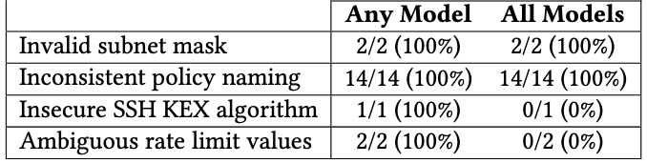
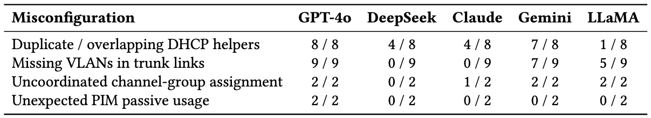
Evaluation: New (false) misconfigurations identified
👍 Identifies 19 previously unknown misconfigurations
and no false positives in medium campus
👎 All reported misconfigurations in large campus are false positives

Slide 18
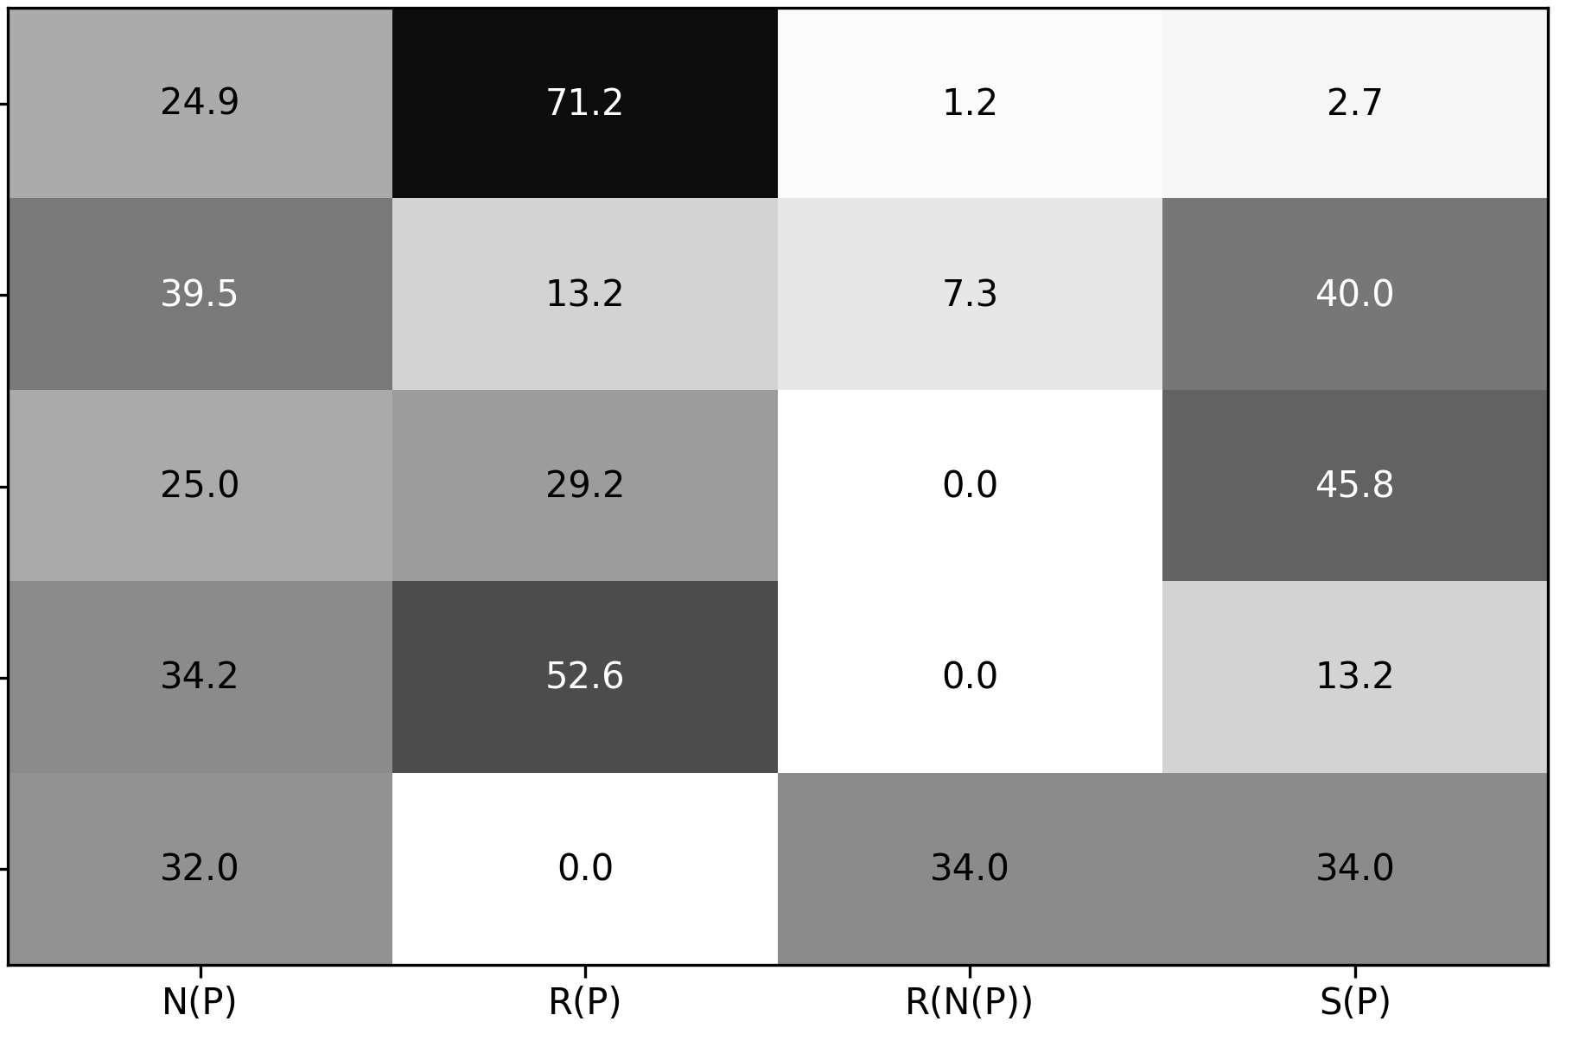
Evaluation: Context requested by LLMs
Diagnostic signal for models’ internal strategy
Does letting models choose context
(to avoid overload) lead to insufficient context?
Providing all context
reduces GPT-4o’s false positives (by 4x)
but requires
3x larger prompts
GPT-4o
DeepSeek
Claude
Gemini
LLaMa
Neighboring | Referenced | Referenced by neighbors | Similar

Slide 19
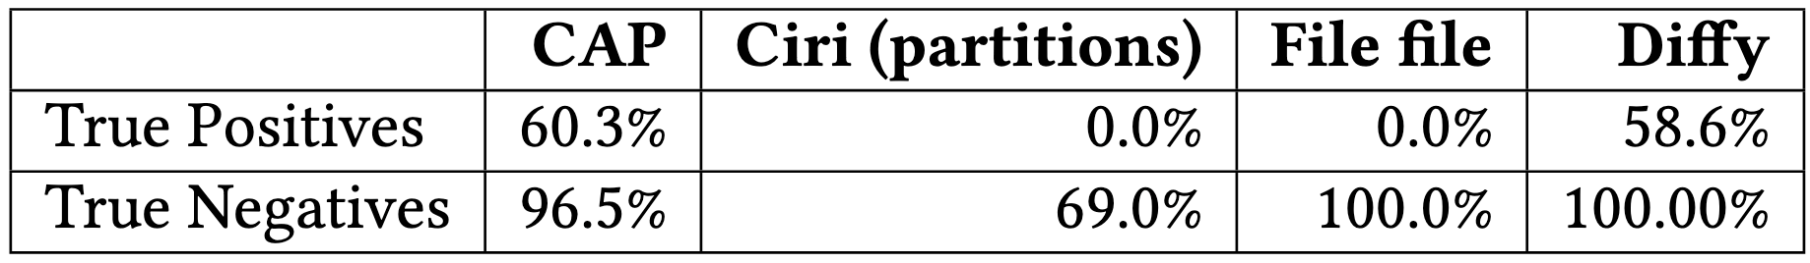
Evaluation: Comparison with existing verifiers
58 synthetic updates to Internet2 configurations
👍 Significantly higher accuracy than
alternative LLM-based approaches
👍 Accuracy on par with state-of
-the-art consistency checkers

Slide 20
Summary
LLM-based configuration verification avoids the high-manual effort, shallow analyses, and lack of explanations with classic verifiers
Context-Aware Prompting (CAP) enables an LLM to reason about network configurations like a human expert
  Identify potentially relevant neighboring, similar, and referenced configuration
  Prompt the LLM to specify the context it needs
CAP accurately identifies misconfigurations involving references, and LLMs that request similar configuration produce fewer false positives
Further work is needed to accurately detect missing configuration and broaden the context available to LLMs

Slide 22
1. Context mining: configuration representation

Slide 23
Evaluation: Accuracy on know real misconfigurations

Slide 24
Future work
Ensemble of LLMs
Additional forms of context — e.g. historical evolution,
operator intent, runtime data
Agent-based approach

